Slide 1
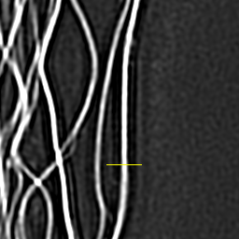
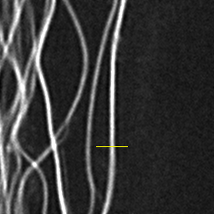
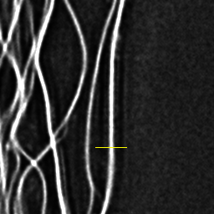
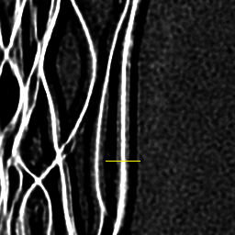
Cropped, contrast-enhanced image
Radially-averaged Fourier image plot
Line profile
RL: 5
w: 0.2 a: 0.1
RL: 1
RL: 1
RL: 5
RL: 5
RL: 20
RL: 20

